Slide 1
AdEvent Astra
Horoscope & Nasa API application

Slide 2
Elevator pitch
1 minute
Tamara
Hi, we are group AddEvent Astra (because love astrology and adding event listeners 🙈🤓✌️)
Employers want to see what we can do, BUT they also want to see how we work with other developers.
Our aim for this project is to create a web application that solves a real-world problem by using multiple server-side API requests. Our group used what we’ve learned to create an online horoscope with interactive Nasa images. This will be a project that we’ll be able to showcase to potential employers.
To help us work together, we used agile development strategies such as kanban boards and roadmaps to set time-frames and roles.
In the following slides, we will describe how we worked as a team and the project's journey.

Slide 3
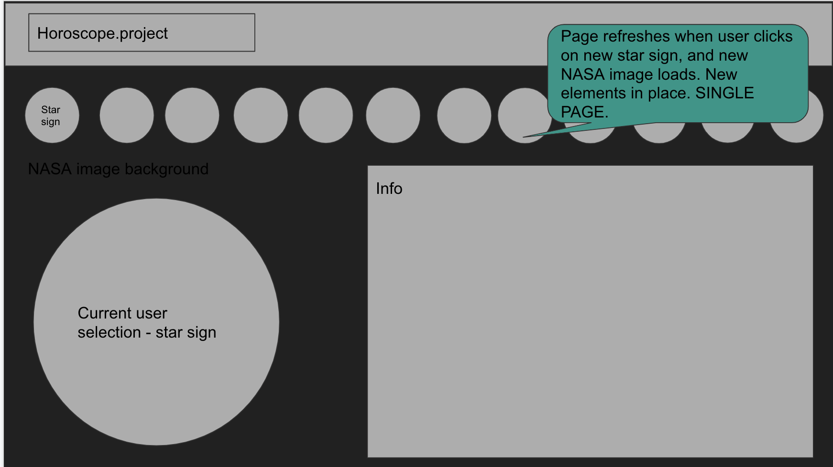
Concept
1 minute
User story
AS AN astrology and astronomy enthusiast
I WANT to see my horoscope outlook and nasa space images
SO THAT I can view my predictions accordingly
Description:
When the user clicks on their star-sign, their star-sign profile and horoscope prediction comes up.
When the user clicks on the nasa button, the background changes to a nasa space image.
Motivation for development?
To collaboratively create an online horoscope with interactive Nasa images, this will be a team project that we can showcase to an employer.
Rebecca
Pip
Tennisson

Slide 4
Process
1 minute
Rebecca
Technologies Used -I created the navbar and buttons using HTML and CSS in conjunction with Bootstrap -Liaising with our team, AddEventAstra, regarding the rest of the website -Used GitHub with understanding of the Git flow in order to help manage the project
Challenges -Resolving conflicts on GitHub when merging -Helping team members with JavaScript related queries
Successes -Created a navbar with logo plus functional buttons -Gained confidence in working as part of a team

Slide 5
Process
1 minute
Tennisson
Technologies used:
I created an image of NASA using HTML.
I utilized GitHub and a knowledge of the Git flow, and vs code to participate during the project implementation.
Breakdown of tasks and roles:
Breaking down tasks was a good strategy that allowed the project to move more quickly than expected because each team member knew exactly what to do. This also aided in determining which members of the team required additional assistance.
Challenges:
I initially struggled with API (getting keys and data from it), but I now understand it well.
Successes:
Working as a team appears to be an unforgettable memory because the ideals shared in a group appear to be imprinted in the memory forever.

Slide 6
Process
1 minute
Pip
Technologies used
I used local storage to retrieve the user’s chosen starsign.
Breakdown of tasks and roles
We broke down our tasks and roles according to the various features of our project, each of us taking a different element. I felt this was a really good way to organize ourselves because it made it easy to focus on what I was responsible for while also understanding what other people were doing and hopefully was able to provide some support for my team mates .
Challenges
I felt I over complicated my function and got a little lost, throwing variables everywhere. After some help i got it sorted out. Git as usual caused some trouble but I learned a lot about git in VS code and also how to merge.
Successes
I enjoyed working in a team and found I was comfortable asking for help and keeping on target with what we were trying to achieve. We have a fully functioning sight with room to add more features like modals giving the starsign’s personality and traits in future and predicted mood. It would be nice if the NASA api could be refined to show only images of space or even just the planet or constellation that pertains to their sign.

Slide 7
Process
1 minute
Tamara:
-Technologies used:
-Nasa and Aztro Server APIs
-Html, CSS, JavaScript, Bootstrap, jQuery, Google Fonts, GitHub
-Tasks/ Role:
-Incentivized and led group discussions around project concept and the wireframe.
-Outlined roadmap with milestones and timeframes for each of the team members.
-Built the right-hand side of the page where the horoscope description will show.
-Worked collaboratively to create the Nasa API background.
-Offered and provided support to other group members.
-Challenges:
-Debugging JavaScript, applying the concepts we learned
-Issues around GitHub branches pushed up and overriding updated work on the repo.
-Successes:
-Created a functional horoscope description and Nasa background linked to working APIs.
-Set realistic targets and timeframes for members (*discussed and agreed).
-Clearly and regularly communicated targets and outlined expected results to each of the team members

Slide 8
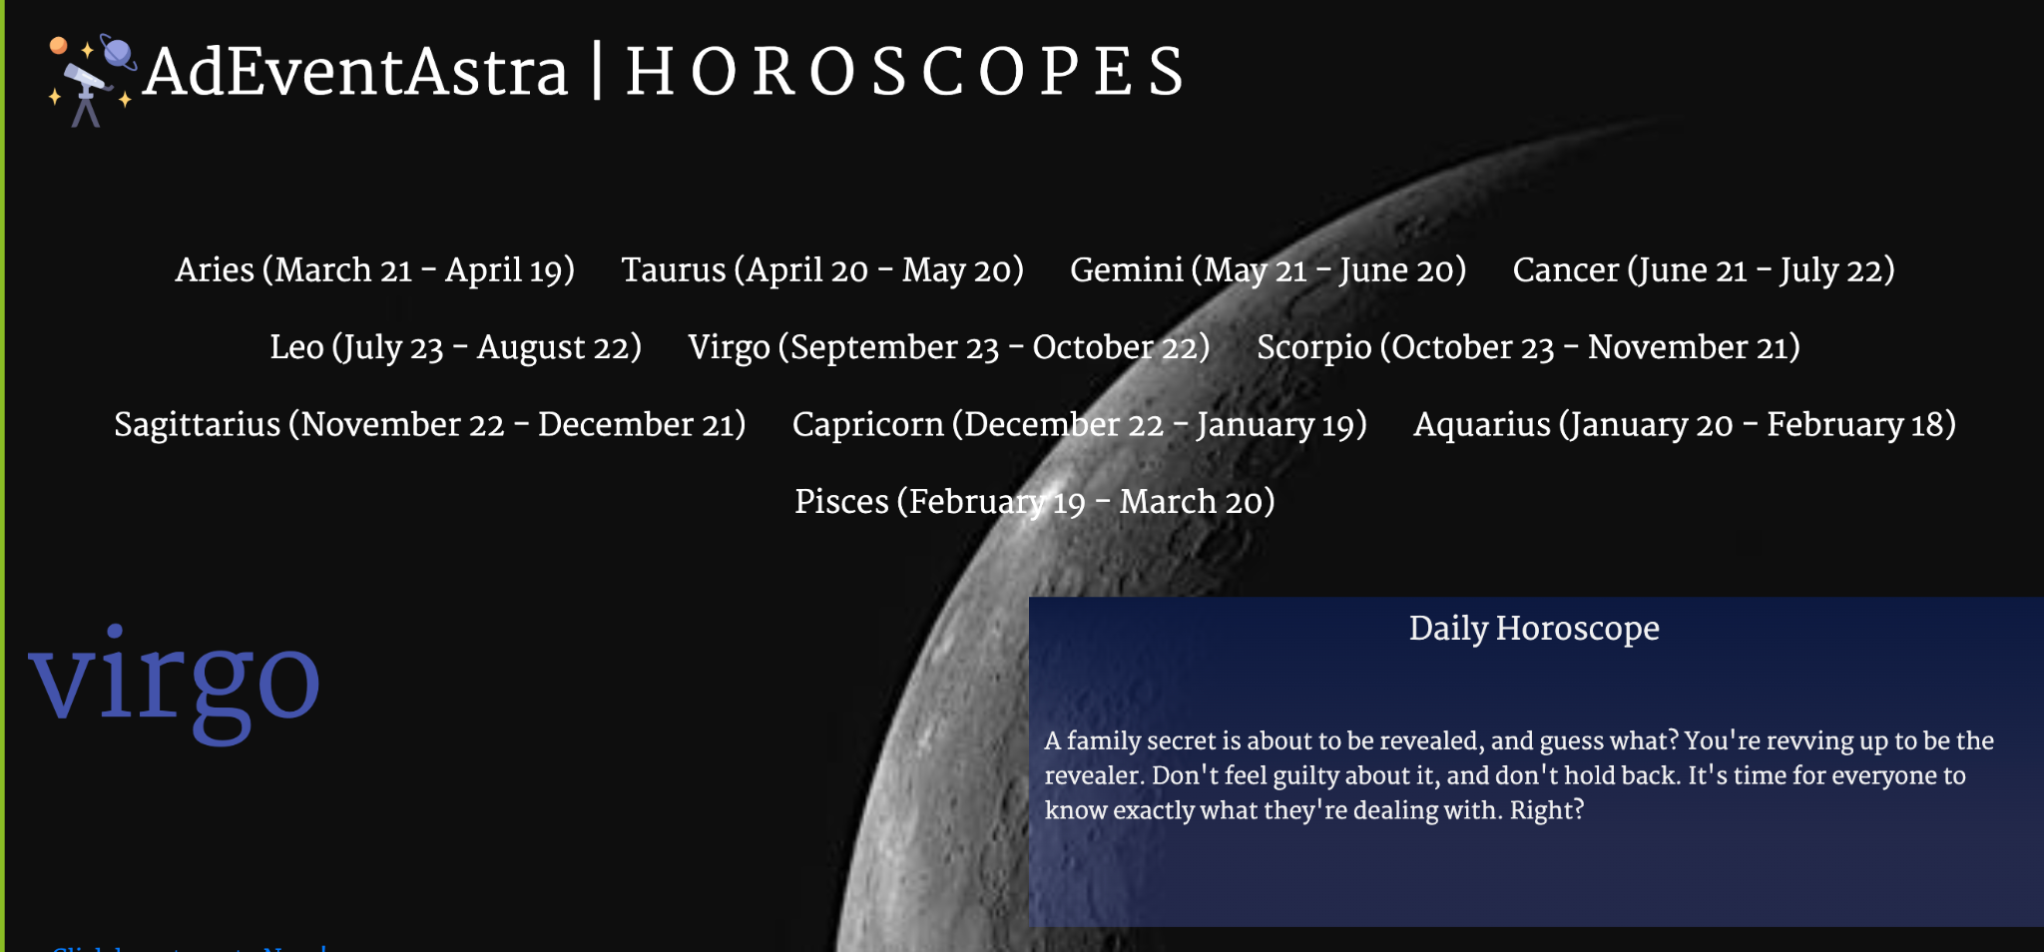
Demo
1 minute

Slide 9
Directions for Future Development
1 minute
Get NASA api to be refined to show only images of space or even just the planet or constellation that pertains to their sign.
Polish off the design to look more streamlined
Improve the layout to be more user-friendly
Add a search history

Slide 10
Links
1 minute
Deployed https://adeventastra.github.io/project1-piptambecten/
GitHub repo https://github.com/AdEventAstra/project1-piptambecten

